Slide 2
To Do List
Complete tasks on your own figure slides
Clean up code and push to github (and let Kathryn know)
Take out any unnecessary code
Make all figures look the same (Kathryn)
Make maps (Smriti)
Map with:
Colored point for every species included in figure 2a (with connecting lines)
Different colored point for every species included in figure 2b (with connecting lines)
Different colored points for every species in figure 3
Complete writing tasks (on LegumeMetaAnalysis_PaperOutline)

Slide 3
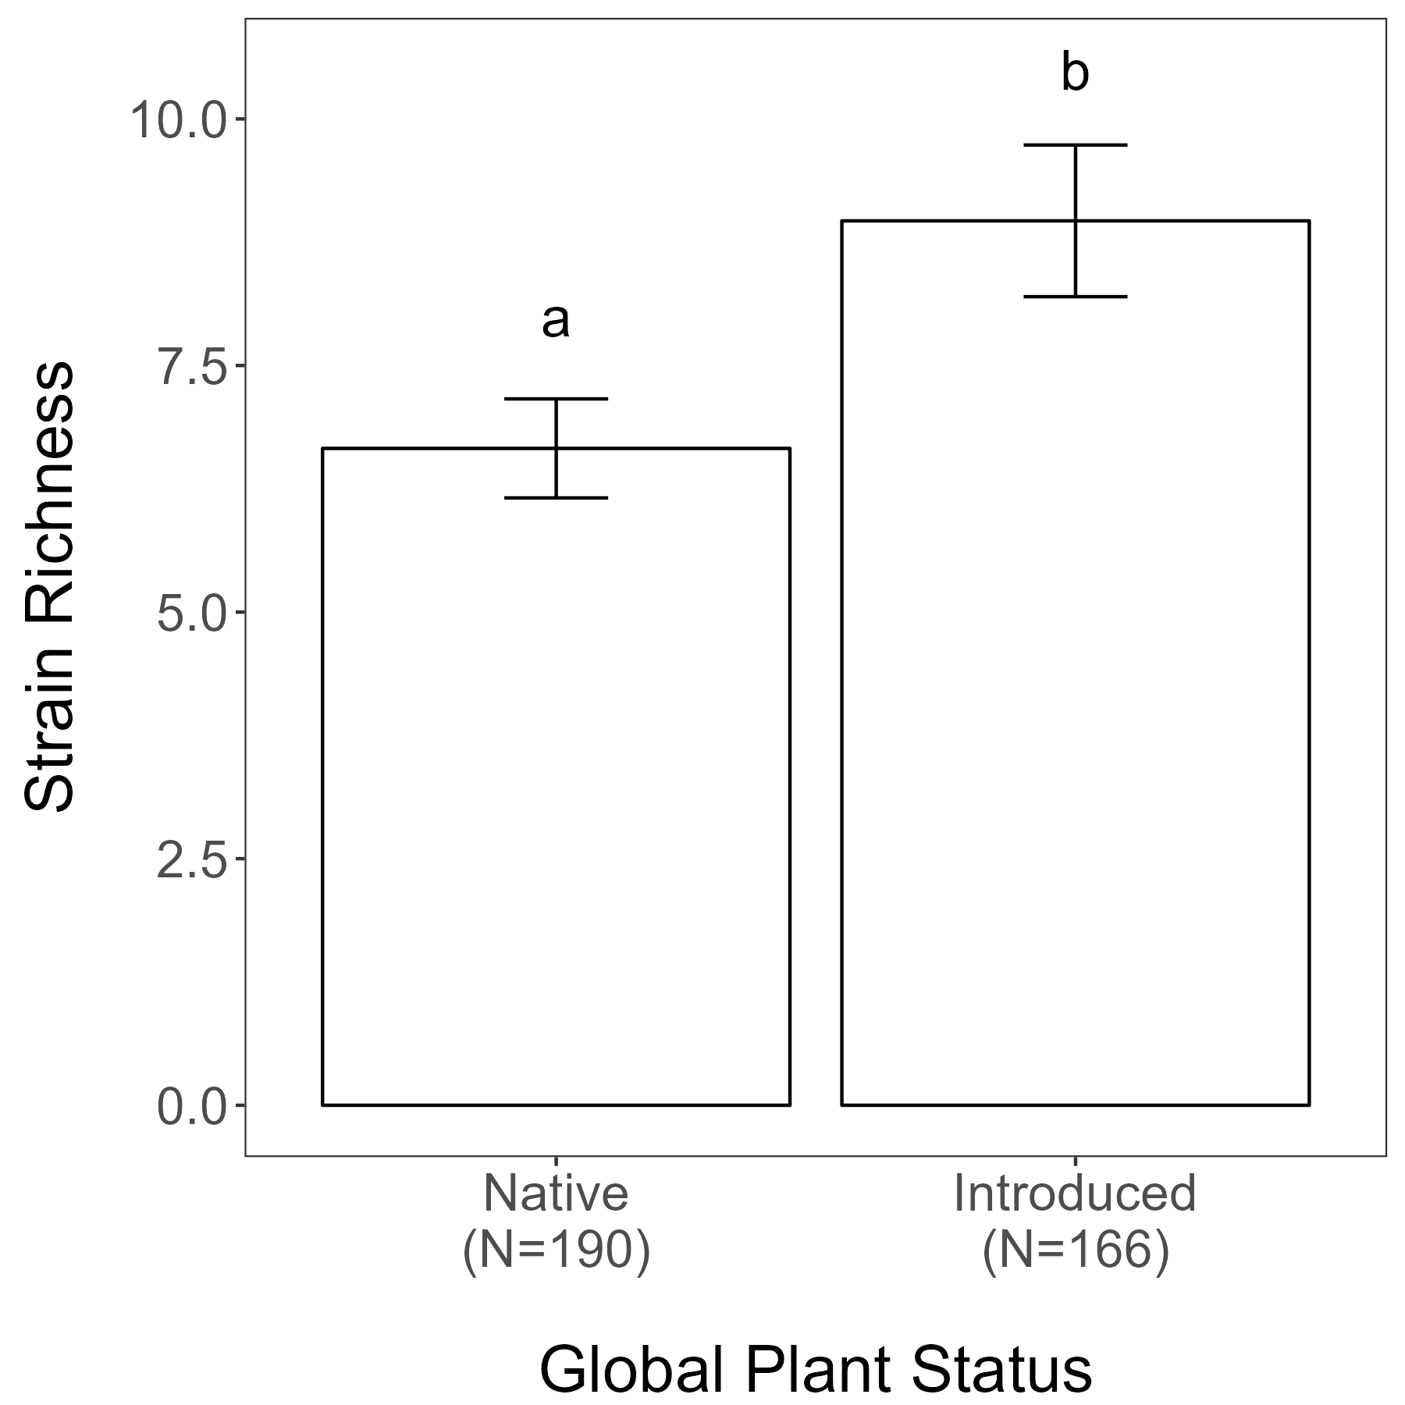
Figure 1
Question 1: Do species that are globally native have a different strain richness than those that are introduced somewhere in the world? (regardless of where the samples were collected, this is the global plant status)
lm(log(strain_richness) ~ global_plant_status
Averaged across gene regions and papers (one number for each plant species; plant species are our “replicates” in this analysis)
Idea: What is the general trait of plants that are successful in non native areas
Results:
Globally legume species that have been introduced associate with more rhizobial strains than those who are not non-native anywhere in the world.
Gives evidence for non-native legumes being more generalists which might promote their ability to succeed outside of their native range
F_{1,350}=6.8909
p=0.0090***
Notes:
This cannot have a pie chart, it doesn’t make sense for this figure

Slide 4
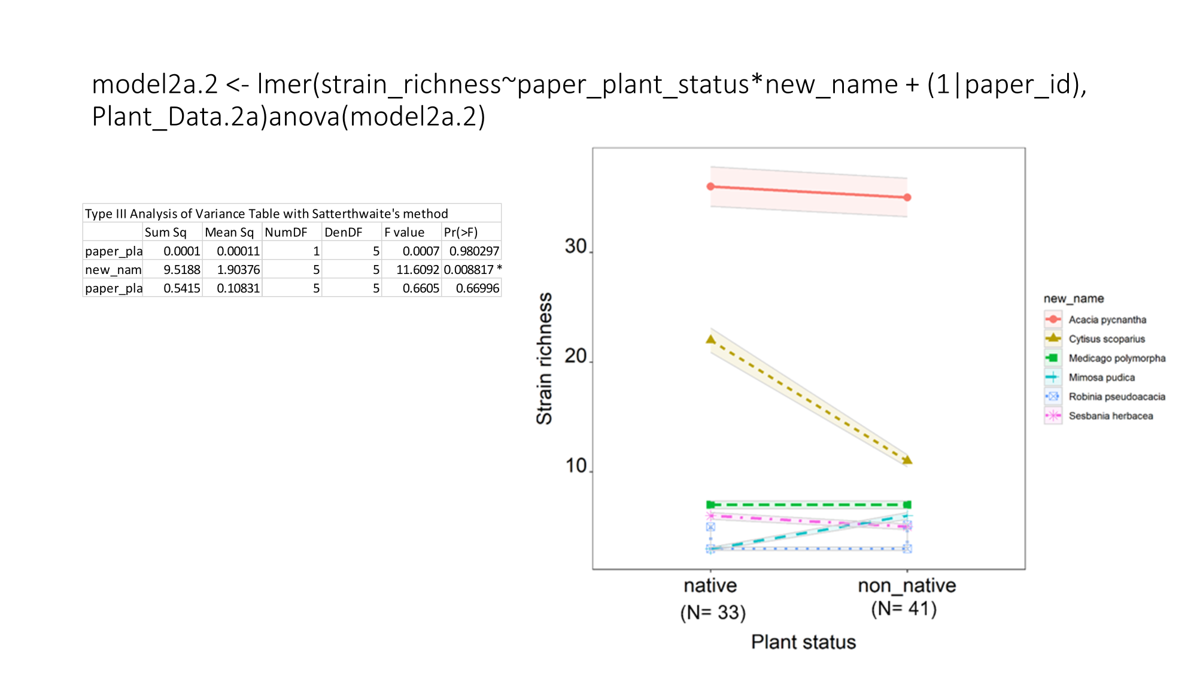
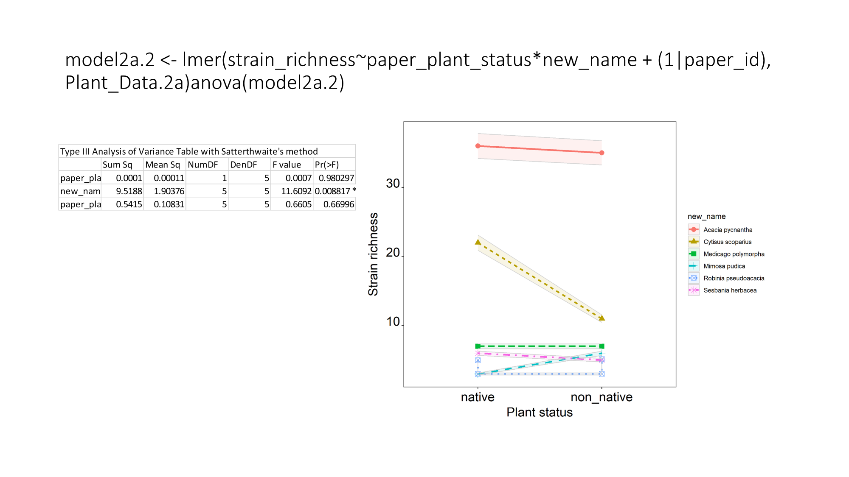
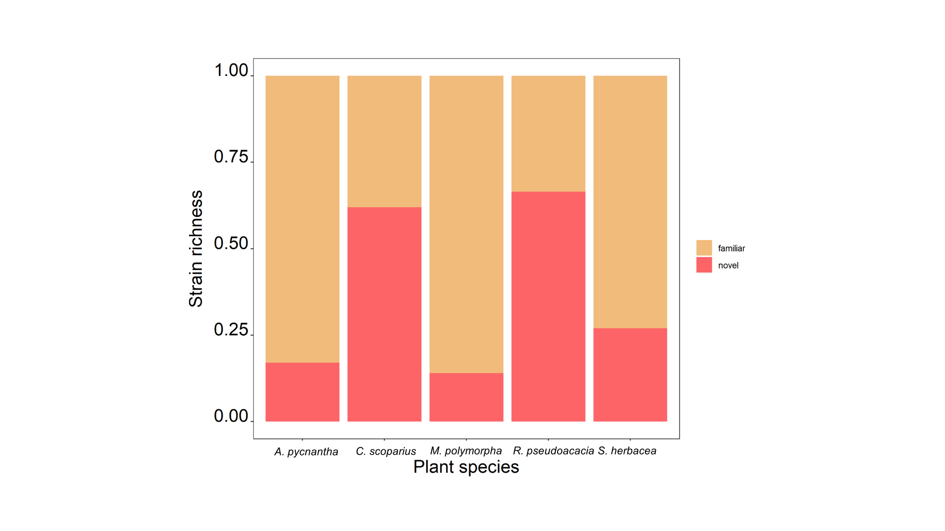
Question 3: Subset of Data: comparing within the same study
Figure 2 A
Question 2a Are non-native legumes utilizing the same rhizobial strains as they do in their native range?
Home vs away (within the same study)
Across species within one site
(violin or boxplot)
Model 1:
Strain# ~ plant status*growth form
Random Effects:
Study
Species
Number of nodules collected(?)
Number of plant collected(?)
Model 2: lifespan instead of growth from (check data first)
Include on Figure: N, percent of strain overlap (include n number and CI)
Kathryn
Idea: Home/Away (Following the idea that species that occur outside of native range associate with more rhizobial species, do we see a difference if those plants are in their native vs. non native range)
Results:
Overall, regardless of whether plants are in their native or non-native range there is no difference in species richness
Follows idea that this higher strain richness is a key trait of non-native plants (no matter where that plant grows, it is going to have higher strain richness)
But there is a difference based on plant species
To Do:
Add pie chart of overall percent novel vs familiar strains in corner and then also mini-pie charts next to each species
Number of Strains
(per individual plant)
Native
Non-Native
Native
Non-Native

Slide 5
2a.
To Do:
Make this into a pie-chart and add to figure in slide 3 (split out by species & average in corner)
Idea: Of the total number of strains that non natives are associating with, how many are strains that they associated with in their native range compared to how many are novel associations
Results:
C. scoparius associated with fewer strains in its non-native range compared to its native range and it had more novel strains
There is a lot of variability across species - patterns are species specific
Maybe the plants that can associate with more novel species can be more successful in non-native ranges? OR plants that can somehow find their familiar strains outside of their range are also successful (are they bringing their symbionts with them? Or are they able to find them in the new area?)

Slide 6
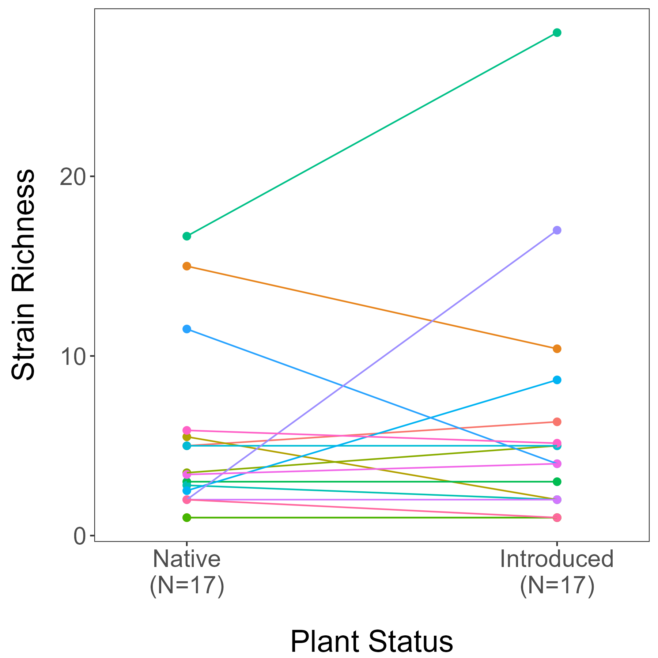
Figure 2b
Question 2b: home and away comparison across studies (same species, different studies; excluded Smriti’s Fig 2a studies)
lmer(log(strain_richness) ~ plant_status +
(1|clean_name)
Only includes 16S gene region and papers (one number for each plant species; plant species are our “replicates” in this analysis)
Idea: scaling out across papers
Results:
Some species lose/increase strains when they get to non-native range, most stay the same
Only 6 species where people explicitly ask this question (fig 2a) and when we scale out across papers we find supporting evidence for the pattern that non natives associate with the same number of strains in their native and non native range
To Do:
Pull accession numbers
Pull data
Make pie chart comparing what proportion of are familiar vs. novel
F_{1,18}=0.0453
p=0.8339

Slide 7
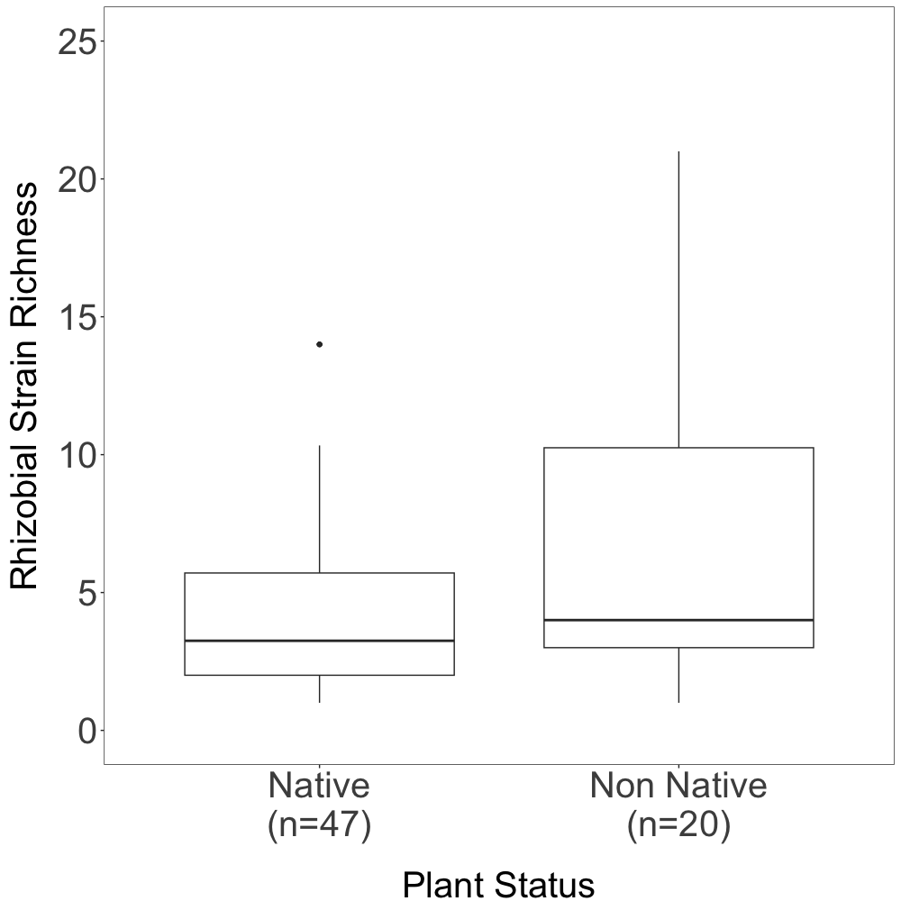
Figure 3
Question 3: Do species that are non-native in a given area associate with the same number of rhizobial symbionts as those that are native in the same area?
lmer(data = Native_NonNative_Fig1, strain_richness_TF ~ paper_plant_status + (1|paper_id))
Averaged across gene regions within a paper
Idea: when species leave their range, do they associate with the same number of rhizobial strains as natives in the new range
Results:
Non-natives associate with the same number of rhizobial strains as natives in a given area though the spread is much greater for non-natives
Anticipated Results:
There should be ~50/50 overlap between novel and familiar strains for non-natives
To Do:
Extract overlap data
Create pie chart in corner of figure
F_{1,54.24} = 0.2027
p = 0.65

Slide 8
Question 2: Subset of Data: comparing within the same study
A. Within a species across its range
Model 1:
Strain# ~ plant status*growth form
Random Effects:
Study
Species
Number of nodules collected(?)
Number of plant collected(?)
Model 2: lifespan instead of growth from (check data first)
Include on Figure:
One dot for each species N, average percent of strain overlap (include n number and CI) - consider coloring dots by % overlap
Smriti
B/C. Within a species across its range (averaged across studies)
B. Include all studies where we can genetically compare minus studies from panel A (NMDS, are they the same strains?)
C. Include all studies, regardless of genetic region (put gene region in random effect)
Model 1:
Strain# ~ plant status*growth form
Random Effects:
Species
Number of nodules collected(?)
Number of plant collected(?)
Model 2: lifespan instead of growth from (check data first)
Include on Figure:
One dot for each species
N, average percent of strain overlap (include n number and CI) - consider coloring dots by % overlap
Kim
Number of Strains
(per individual plant)
Native
Non-Native
Native
Non-Native

